Slide 1
Cross Enrollment Across Colleges to Increase Student Access
CHUGACUG-4CUG Conference
July 2021

Slide 2
Presenters
John Hadad
Product Manager
California Virtual Campus
Mike Vogt
Supervisor, Project Management & Operations
California Virtual Campus

Slide 3
Why is cross enrollment important?
Accelerates time to completion
Colleges often lack data on live search and enrollment trends
ERP variance at 116 institutions across the state
Reduces the fragmented student experience.

Slide 4
How does cross enrollment address these issues?
Centralized course search to serve 2.1 million students.
Live section availability (including seat counts) via SIS integration.
Provides related information (e.g., transferability, cost)
Cross enrollment without an additional application.
System-wide and college-specific search data and enrollment reports.
Notes:
John - Student Equity

Slide 5
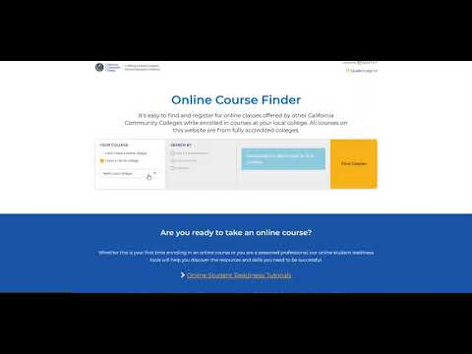

Slide 6
Partners, Products, and People
Partnerships with vendors and colleges have been key to the project's success
The "solution" is an ecosystem, not a monolithic vendor product (e.g. eTranscript California, SSO Proxy, Canvas/Instructure, SIS Vendor Support, etc.)
The project is largely people and relationship-oriented
Notes:
Mention Ellucian, N2N and Quottly

Slide 7
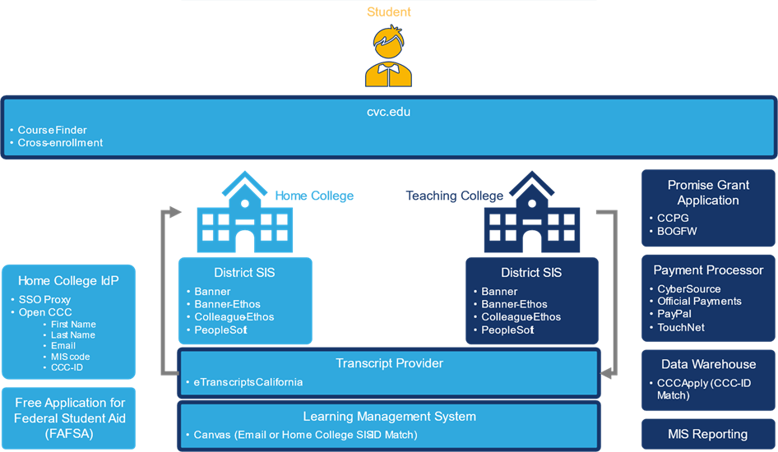
System Architecture

Slide 8
Ethos is Elementary to Success
Benefits of Ethos
Integration Platform/Hub
Allows Colleges to assert greater control over integration points
Streamlined Access to Data
One-time Setup - Long term impact
CVC Integration
Required for Colleague SIS
Preferred for Banner SIS Integration
Data Mapping in Ethos is Critical
Application can be set up quickly

Slide 9
Ellucian Partnership
Strategic roadmap for Ethos Rollout
Ellucian has enhanced the Ethos product to address identified needs
Strong support for Ethos API’s

Slide 10
Lessons Learned
Need college/district senior leadership to support prioritization of project.
Often competing with other high-priority projects.
Provide support and guidance for product and processes
Leveraging integrations with various products and services
Provide a self-service option for increased implementation capacity - Ethos makes it easier!

Slide 11
Future of Cross-Enrollment
Process Automation
Financial Aid Processing - we need your help!
Student residency validation
Expanded support for Prerequisite clearing and Co-requisite registrations
Continue to leverage Ethos integration for Product Enhancements
Enhanced/Automated Data sharing across ecosystem
MIS data
eTranscript
Notes:
Based on direct feedback from colleges

Slide 12
More Info
CVC Exchange Info: https://cvc.edu/exchange/
Search for Classes: cvc.edu

Slide 13
Questions?

Slide 14
CONTACT INFORMATION
John Hadad
jhadad@cvc.edu
Mike Vogt mvogt@cvc.edu

